Slide 1
EmoGenius Crew
An Innovative Android Appication
TEAM MUMBERS: WangYifan, LuYuhao, WangYanbo, ZhengBinyue
Zhangxindan, ZhengHaoyuan, Wuguohua, LiGuandong, ShiTianjun, FanJinzhen, WangZhaoyou, XueYiyang
Software Engineering

Slide 2
1
Introduction
2
Overall description
CONTENTS
3
Specific requirements
4
Interface prototype
5
Function description and acceptance verification standards

Slide 3
01
Introduction
PART ONE

Slide 4



Introduction
Software name：Feeling Together
Project task proposer：EmoGenius Grew
Project developer：EmoGenius Grew
Purpose of writing
In today's society, emotional health is a prominent topic worthy of attention. With the acceleration of the pace of life and the rapid popularization of digital technology, people face unprecedented emotional challenges. These individuals may be surrounded by all kinds of emotions, but they are not sure how to effectively handle and express these emotions. Therefore, the purpose of the project is to develop an Android application that integrates emotional analysis, social interaction and emotional support. Our goal is to provide a platform that allows users to recover their emotion frankly, understand their emotional state, and share with others and get support.
Project background
Norm of computer software requirements specification
References

Slide 5
02
Overall description
PART TWO

Slide 6

Objectives
Development intention
Based on humanistic care, our team strives to use the Android platform to relieve stress and share emotions through this Android platform. Let users frankly record their emotions, understand their emotions in depth, share with others, and get support. The motivation behind this application is to encourage positive emotional expression, promote social connection, enhance emotional health, and become more confident, positive and emotional elasticity.

Slide 7

Objectives
Application goals and scope
This application is mainly for people who have strong desire for emotional sharing in daily life. This type of population is happy to publish on the Internet in the form of an emotional diary that can cause emotional changes in life. Essence Our group is expected to take the students as the first batch of promotion targets and gradually develop to those who intend to use the software, especially the target group that meets our plan.

Slide 8
Objectives
Product Prospects
Challenges in Current Apps
Our Vision
Negative culture and misunderstandings prevail in existing
social apps due to a lack of emphasis on user emotions.
Introducing a revolutionary approach –
Integrating intelligent emotional robots
for a purer emotional sharing and
analysis experience.

Slide 9
Objectives
Product Prospects
Technological Assurance
Utilizing advanced emotional analysis and language processing to ensure deep emotional interactions without risks.
Our unique approach sets us apart, providing users with a novel and intelligent emotional experience.
Emo
Genuis
Unique Features
Social Interaction: Users can socialize, share emotions, and seek support.
Emotional Bots: Deep interactions with intelligent emotional robots.
User Control: Empowering users to decide on social functions.
User-Centric Experience
A platform that prioritizes a pure, intelligent, and caring emotional connection, addressing modern societal challenges.

Slide 10
03
Specific requirements
PART THREE

Slide 11
Subdirectory
3
3.1 Class Diagram
3.1.1 Login, registration and main interface
3.1.2 Function
3.1.3 Server

Slide 12

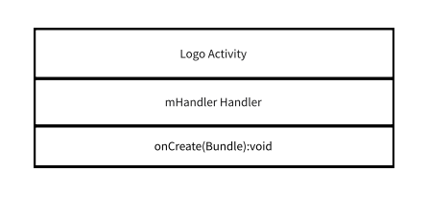
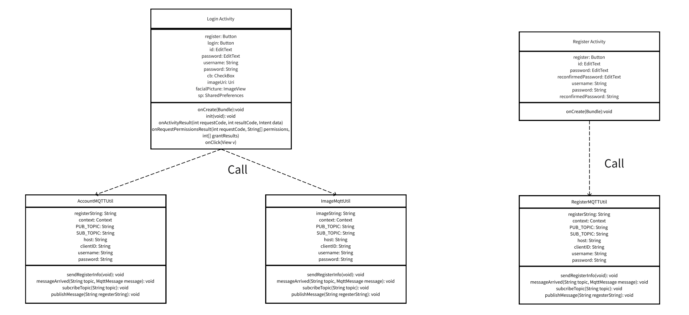
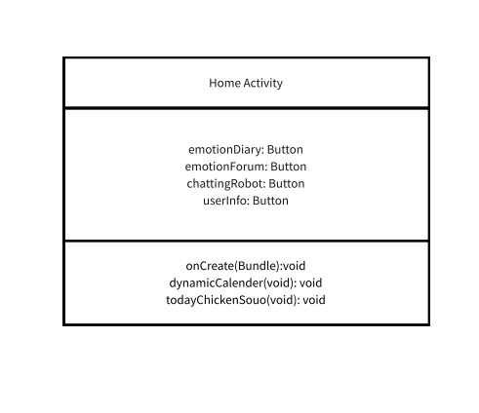
3.1.1 Login, registration and main interface
The project includes account registration, login, and a main interface with emotional diaries, forums, chatbots, and personal information.

Slide 13
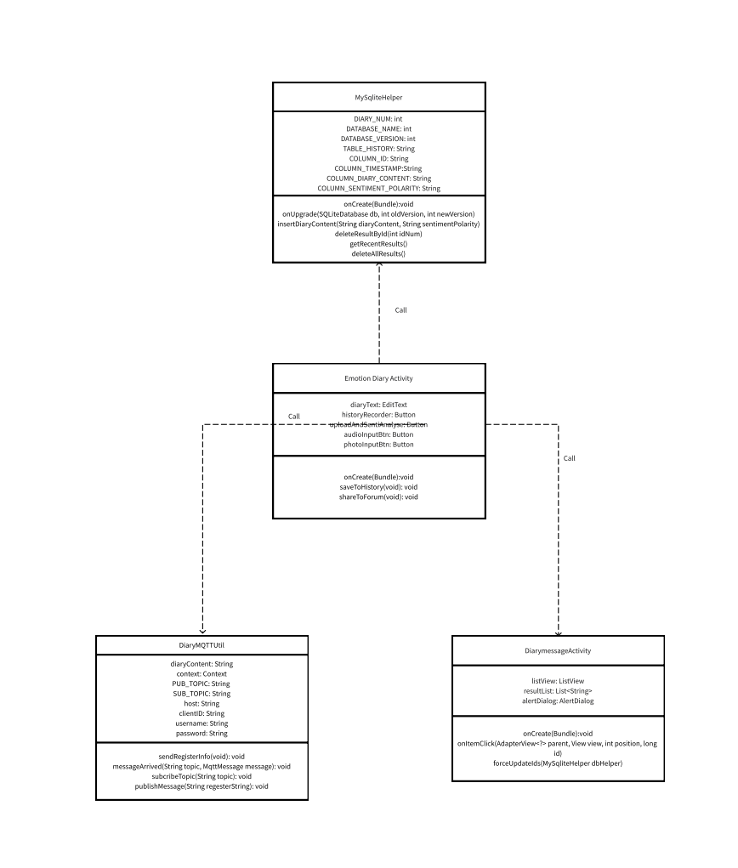

3.1.2.1 Function - Emotional diary
The emotional diary function realizes the basic writing of the text, historical viewing, and voice record function. Through the MQTTUTIL tools, users can upload the diary content to the server and process the return response. Use the Audioutil and Wavutil class to achieve recording and playback functions.

Slide 14
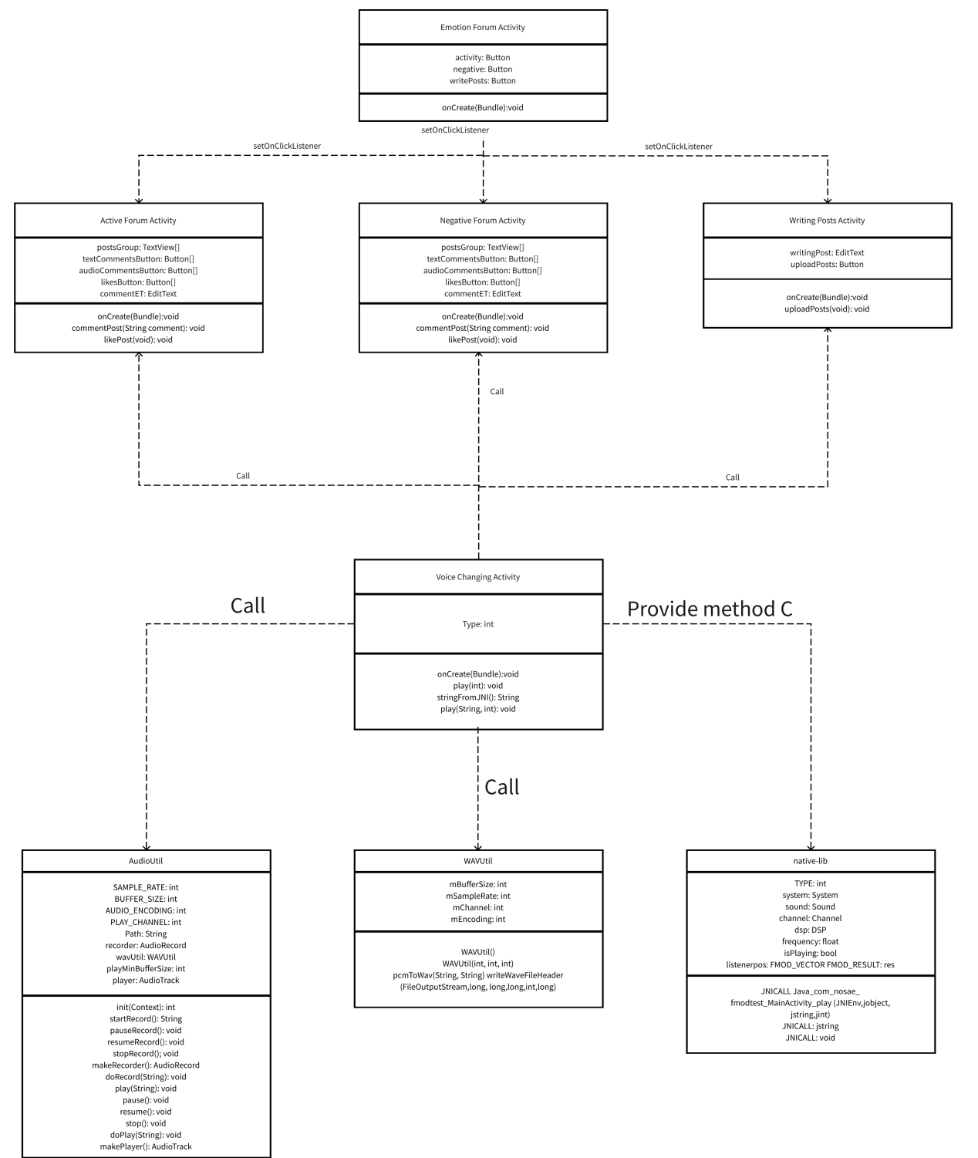
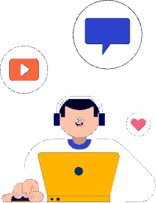
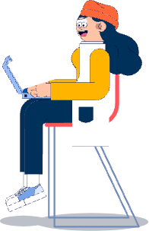
3.1.2.2 Function - Forum
The forum feature consists of six activity classes and multiple auxiliary classes. It aims to provide higher quality user services by utilizing auxiliary tools such as the RichEditorUtil rich text editor and the FMOD audio morpher.

Slide 15
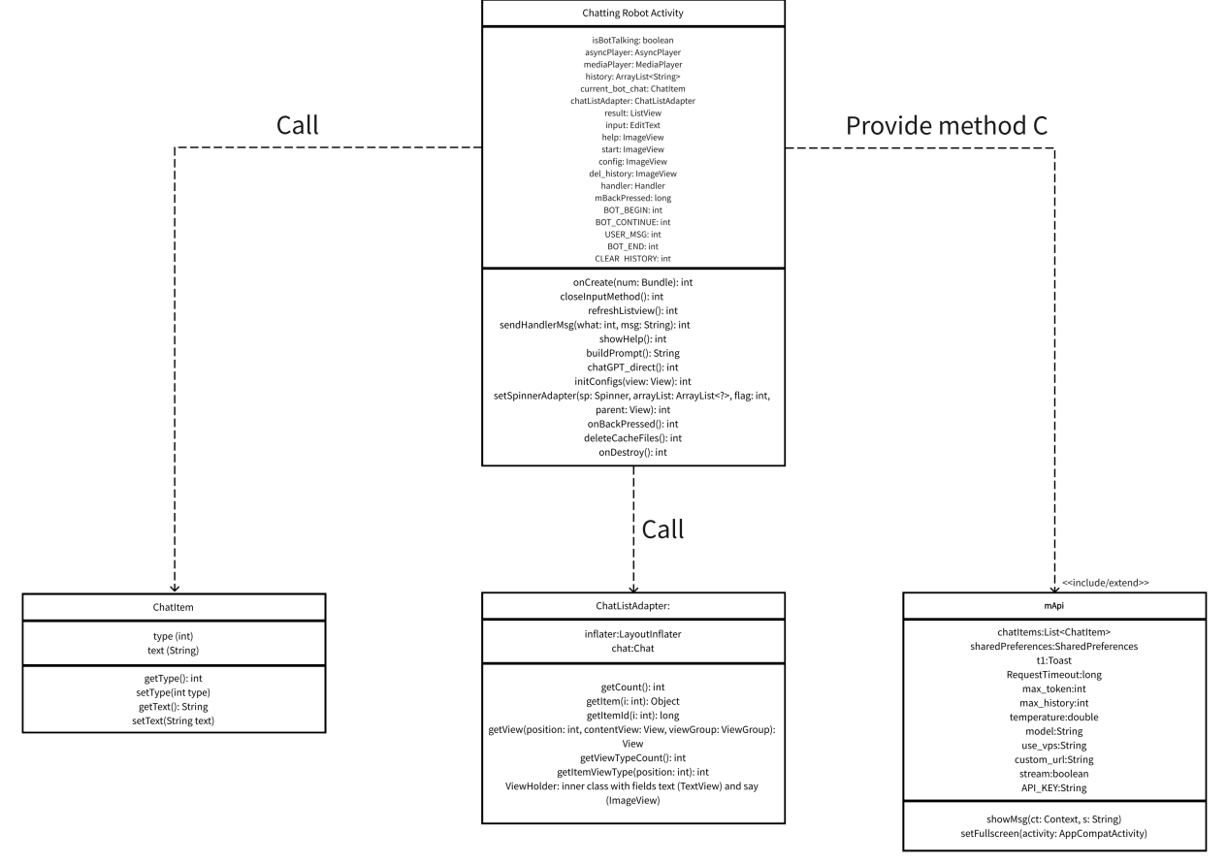
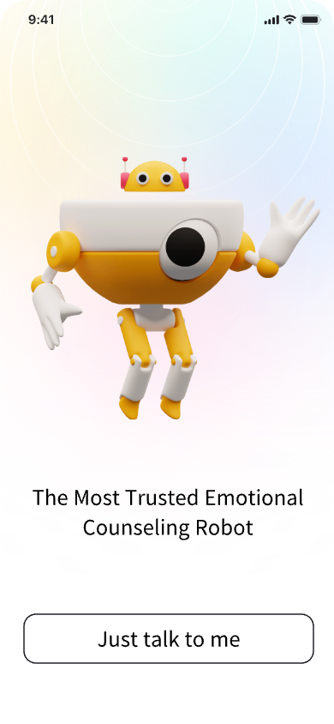
3.1.2.3 Function - Robot

Slide 16
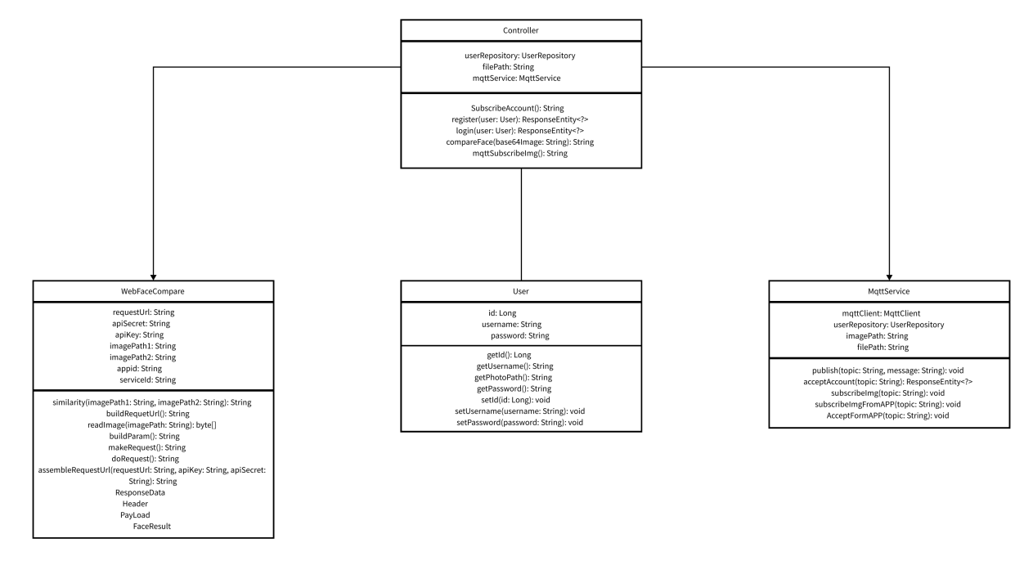
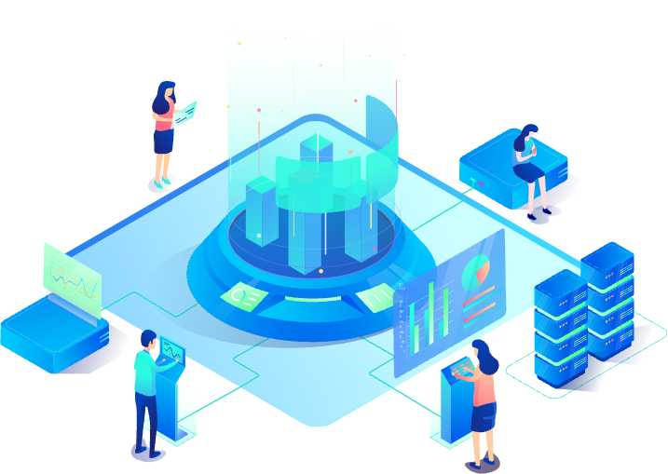
3.1.3 Server

Slide 17
Subdirectory
3
3.2 Properties
3.2.1 Availability
3.2.2 Security

Slide 18
3.2.1 Availability
The project includes account registration, login, and a main interface with emotional diaries, forums, chatbots, and personal information.
1. Stable Servers and Cloud Services:
We can ensure continuous user access to application data by storing it on stable, highly available cloud servers. Opting for trusted cloud providers such as iFlytek Cloud minimizes the chances of server downtime and service disruptions.
2. Performance Optimization:
3. User-Friendly Interface:
Ensuring that the application runs efficiently on various devices, without crashes or excessive response times due to performance issues.
The application features an intuitive and user-friendly interface that is easy to navigate and understand.

Slide 19
3.2.2 Security
1.Data Encryption:
4. Data Storage:
We securely store user data, avoiding plaintext storage of sensitive information by utilizing Android's secure storage options like SharedPreferences with MODE_PRIVATE or MODE_ENCRYPTED.
We use strong encryption to protect user data and sensitive information, securing personal diaries, images, and other private data at all times.
2.Secure Communication:
5. API Security:
We use the MQTT protocol to encrypt data transmission, preventing man-in-the-middle attacks and data theft, thus ensuring the security of information communication.
Before using external APIs, we ensure that these APIs and services themselves are secure and employ appropriate authentication and authorization mechanisms.
3. Permission Control:
6. Compliance:
We request only essential runtime permissions for the app, offering clear explanations and prompts in case users deny permission.
We ensure that our application complies with applicable laws and privacy policies, especially concerning user data.

Slide 20
04
Interface prototype
PART FIVE

Slide 21
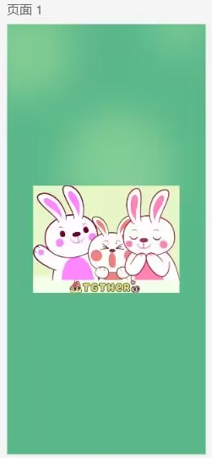
4.1 Opening page
The cover shows the product name and the creative team, with a green background and the product logo.

Slide 22
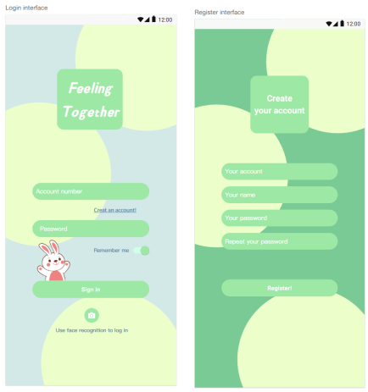
4.2 Login interface
After seeing the frontpage interface, users come up with the Login interface with a big title of our app. A user can use account or face to log in our app.
New users can click ‘Create an account’ to set the account password and other information in ‘Register interface’ page.

Slide 23
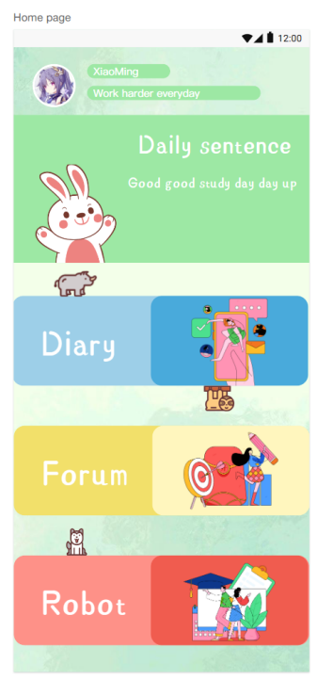
4.3 Home page
A user can touch profile picture to go to the individual center, touch one of three buttons to enter three different modules: diary, forum, and robot.
Also, users can see their user name and the sentence in daily sentence module. These positive sentences aim to evoke better emotions in the users.

Slide 24
Subdirectory
4
4.4 Functions
4.4.1 Emotional diary interface
4.4.2 Forum
4.4.3 emotional counseling robot

Slide 25

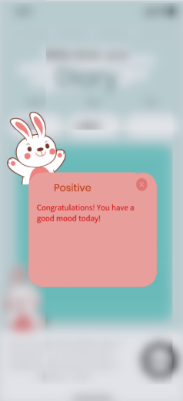
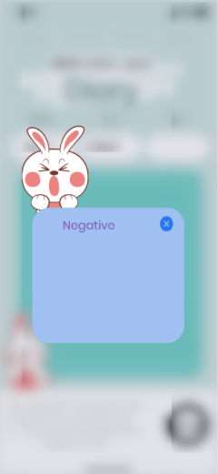
4.4.1 Emotional diary interface
Our group plans to make the emotional diary module a separate interface, which can be entered after the "Emotional Diary" button on the homepage:
1.The main components of the interface: text boxes, function bars, and warm sentences at the bottom.
2.Two pop-up windows: After the user enters the diary and clicks the save button, the system identifies the diary content and determines whether it is a negative or positive partition.

Slide 26
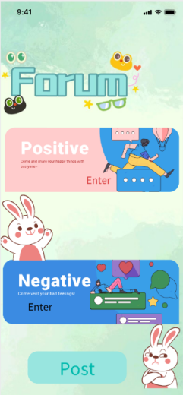
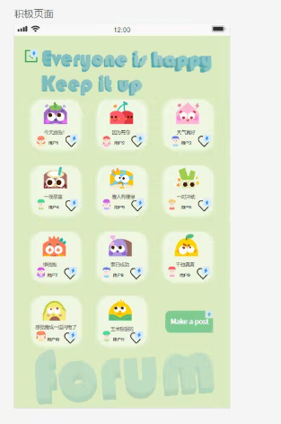
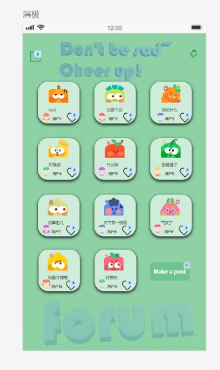
4.4.2 Forum
Our group plans to divide the forum into 4 interfaces, namely: main interface, specific partition interface, posting interface, likes, comments, and reply interfaces for each post.
1.Main interface: Contains entrances for two modules (positive and negative), and a post button at the base.
2.Specific partition interface: User can Click on any box to go to the corresponding details page or just click “like”on this page.

Slide 27
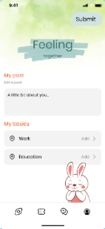
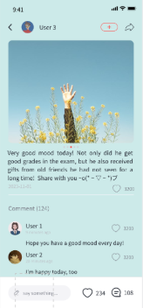
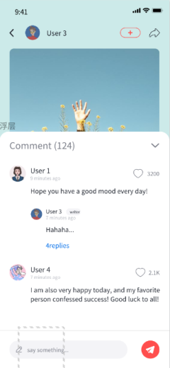
4.4.2 Forum
4.Comment reply interface: After clicking on Specific partition interface, these interface will come up. You can comment on this module, and the author can reply.
3.Posting interface: Enter after pressing "post", input box and publish button

Slide 28
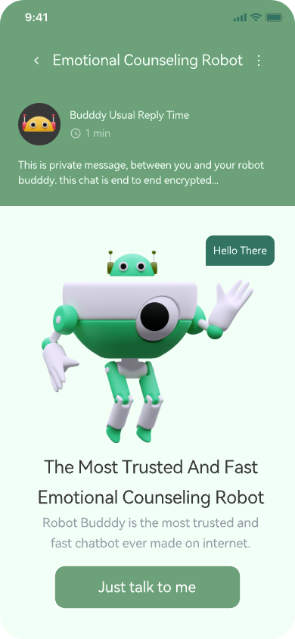
4.4.3 emotional counseling robot
The function of emotional counseling robot is divided into three interfaces: main interface, conversation interface, and messages interface.
1. The main interface consists of: emotional counseling robot function introduction, emotional counseling robot cartoon image display and chat start button (Just talk to me).
After clicking the chat Start button on the main interface, the user can enter the conversation interface.

Slide 29
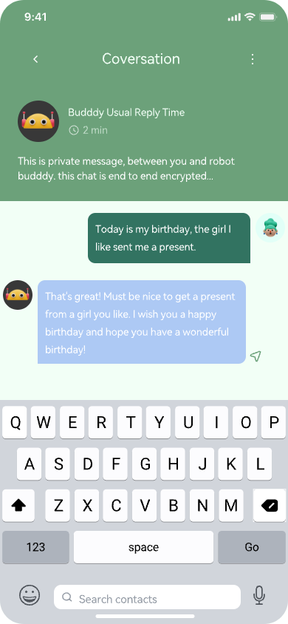
4.4.3 emotional counseling robot
2. In this conversation page, users can click the text input field at the bottom to enter text to talk with the robot buddy, or click the voice recognition button at the lower right corner to convert the user's voice into text information.
The robot will analyze your emotional state based on your words and make responses that help you regulate your emotions.

Slide 30
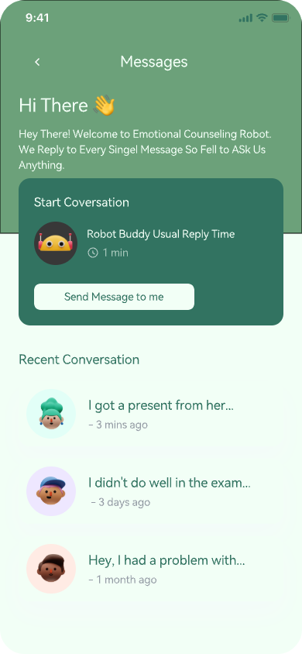
4.4.3 emotional counseling robot
3. Tapping the top right corner of the home screen or conversation takes you to the messages screen, where you can see the bot's specific response time and the user's question history.
Users can re-enter the previous conversation by clicking the button next to historical content.

Slide 31
05
Function Description and Acceptance Verification Standards
PART FIVE

Slide 32
Subdirectory
5
5.1Detailed function description
5.1.1 Registration and Login
5.1.2 Emotional Diary
5.1.3 Emotional Communication Forum
5.1.4 Emotional Communication Robot
5.1.5 Voice Recording and Voice Changing
5.1.6 Emotional Health Recommendations

Slide 33



5.1.1 Registration and Login
Users can log in by providing their username and password, or through facial recognition. The system verifies whether the logging-in user is a legitimate user in the system.
New users who are using the software for the first time need to register, and during registration, their account and password information is stored on the server for comparison during login. This software also offers the convenience of facial recognition for user login.
Registration
Recognition of Face
login

Slide 34



5.1.2 Emotional Diary
Upon entering the software's main page, you will find an "Emotion Diary" entrance. Upon clicking it, users can engage in text editing to record their current positive or negative personal emotions, feelings, and moods in our "Emotion Diary."
Our application sends the diary text to a cloud server and employs the advanced ERNIE pre-trained model for sentiment analysis on the text content. Based on the emotional polarity of the text, the application dynamically adjusts the user interface to achieve emotional resonance with the user.
Diary
Text
Cloud Server

Slide 35



5.1.3 Emotional Communication Forum
We have designed a "Friendship Circle" where users can post content and choose to categorize it manually or utilize our system's automatic topic recognition to distribute their posts to various thematic forums. Users can participate in discussions, share emotional experiences, and receive emotional support.
Within these thematic forums, users can interact, share their emotional stories, offer and receive support and advice. This feature aims to encourage social interaction, provide opportunities for emotional support, and maintain a respectful and appropriate discourse environment.
Circle
forums
emotional support

Slide 36



5.1.4 Emotional Communication Robot
Our software features a highly intelligent emotional communication robot, providing users with personalized emotional support. This robot utilizes natural language processing to understand and respond to users' emotional needs, allowing them to have conversations, share experiences, and receive encouragement and advice. Our goal is for this robot to be a constant source of emotional support.
Technical implementation: We employ GPT-3 to build a custom dialogue system and integrate it with Botpress, an open-source chatbot development platform, to create a tailored chatbot with emotional analysis capabilities.
Robot
GPT-3
Botpress

Slide 37



5.1.5 Voice Recording and Voice Changing
We will integrate speech recognition technology, allowing users to record emotional diaries through voice input, not just text. This includes basic voice input functionality and the use of voice changers in forums, enabling over a dozen voice effects like "loli," "uncle," "ethereal," and more.
This offers multiple options for recording emotions while also addressing user privacy needs.
Speech Recognition
Voice Changer
Privacy Protection

Slide 38



5.1.6 Emotional Health Recommendations
The system assesses users' emotional states based on their emotional diaries and provides certain emotional well-being recommendations for those experiencing negative emotions.
These recommendations may include stress management advice and anxiety relief suggestions.
Emotional States
Recommendations
Stress Management

Slide 39
Subdirectory
5
5.2 Functional Acceptance Criteria
5.2.1 Accuracy
5.2.2 Real-time and stability
5.2.3 User friendliness
5.2.4 Security

Slide 40
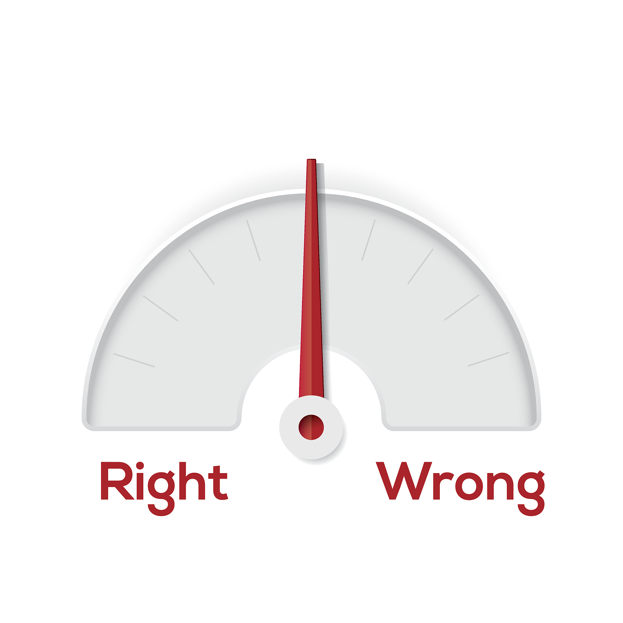
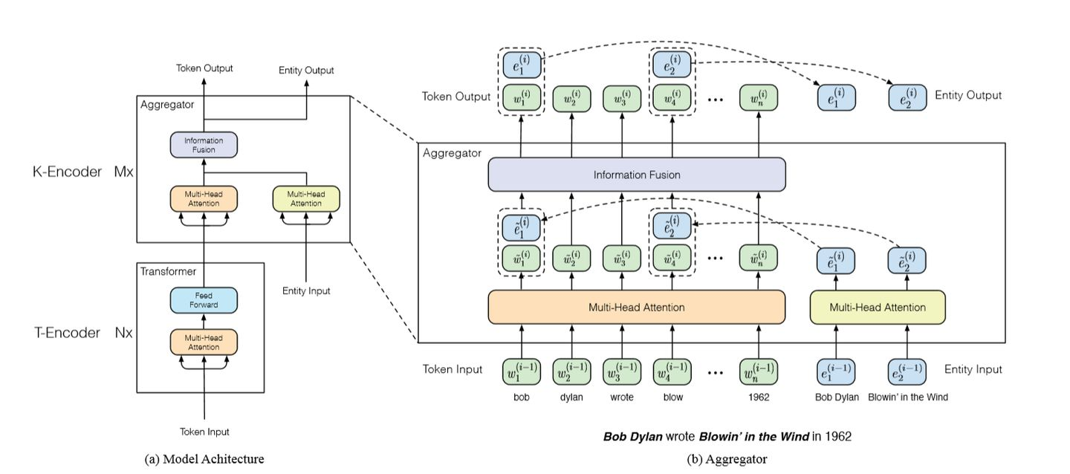
5.2.1 Accuracy
The system utilizes the ERNIE model for sentiment analysis, developed by Baidu Research, which enhances BERT with knowledge-enriched natural language understanding capabilities. ERNIE excels in tasks like sentiment analysis due to its superior performance.
To ensure accuracy, the system's sentiment analysis results are compared with human evaluations through manual annotations of test datasets, ensuring a high level of consistency and accuracy in understanding emotional content in text.

Slide 41
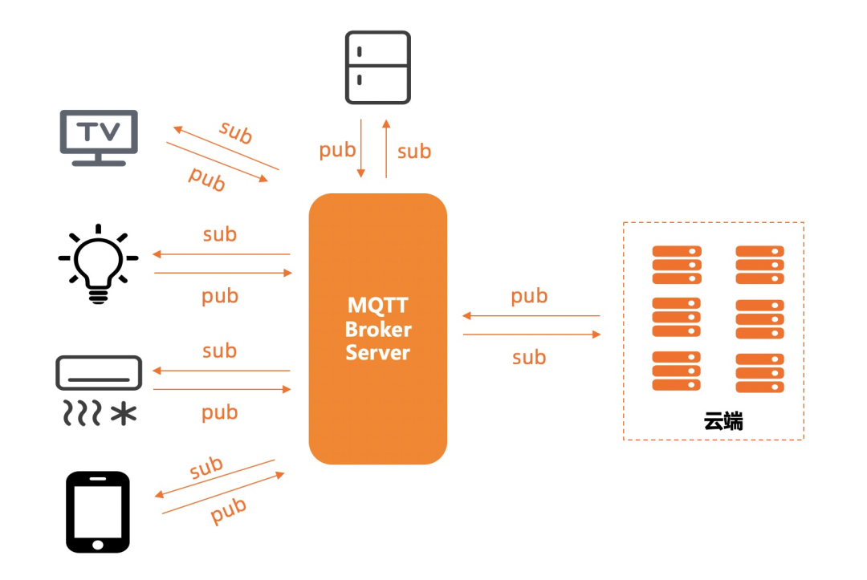

5.2.2 Real-time and stability
The system employs the MQTT protocol for transmitting username, password, and text information to the server. It connects to the server via an MQTT client, subscribes to specific topics, and publishes information to corresponding topics.
The server receives and processes this data, ensuring swift responses. The system offers real-time, efficient, and reliable performance, providing rapid responses to user-submitted text. Real-time capabilities can be verified through performance testing.

Slide 42

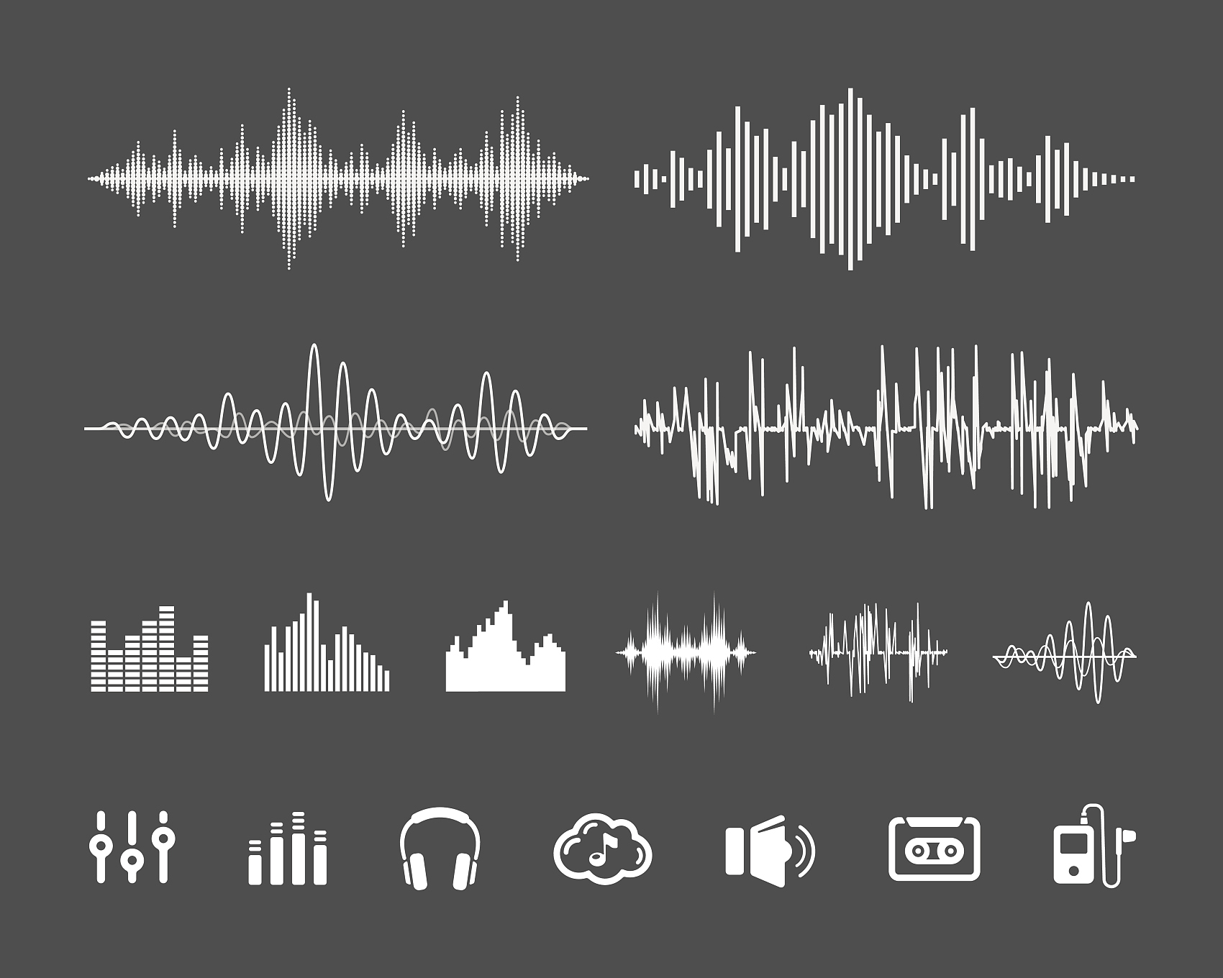
5.2.4 Security
The system interface is clean and emotionally resonant. After users input text, the system present emotional analysis results clearly, helping users understand the emotional nuances and soothing their feelings through appealing visuals.
Furthermore, to safeguard user privacy, the project supports voice modulation using a voice changer. Voice modulation is achieved by importing the FMOD library, an audio engine written in C/C++. Since Android applications are typically written in Java or Kotlin, a bridge through JNI is needed to enable communication and integration between Java code and native C/C++ code.

Slide 43

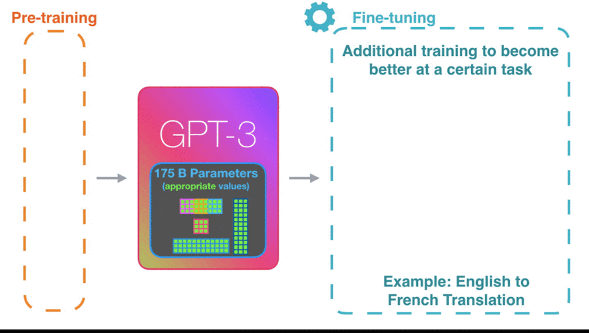
5.2.4 Security
The system must ensure data confidentiality to protect user-entered text information from unauthorized access. Additionally, it must have the capability to handle sensitive text, including appropriate security measures such as data anonymization.
During the project development, we implemented the functionality of the emotional communication robot by making calls to relevant GPT-3.5 APIs. Throughout the project's design and implementation, we thoroughly validated the security of these APIs and employed appropriate authentication and authorization mechanisms to ensure the security and privacy of user data are fully protected.

Slide 44
Thank You
Software Engineering

